Slide 1
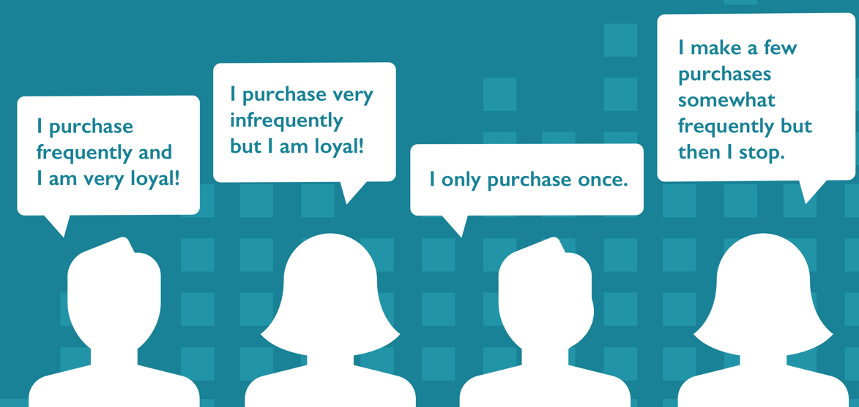
Epsilon Data Science Exercise - Customer Purchase Prediction
Submitted by:
Raj Daiya
Associate Manager,
Data Science
OMD USA

Slide 2
Overview of Methodology
Problem Statement: Predict probability of a customer making a purchase next month?
Feature engineering & attribute selection
Exploratory Data Analysis
Data pre-processing
Split dataset to train & test
Model Evaluation & Output
Modeling
Data & packages import
Exploring data-types of all features in the dataset
Descriptive statistics analysis
Univariate data analysis to understand
Exclude cancelled orders
Remove null values & duplicates
Extract Revenue (“TotalSales”) from existing columns
Removing negative quantities/prices to exclude “returns”
Handling outliers using IQR
Compute RFM (Recency, Frequency & Monetary metrics) per customer (since they give a better insight about the likelihood of purchase prediction better than the other categorical variables)
Generate output labels
Transform RFM metrics into quartiles to “better understand” our consumer matrix
Since we are working on “time-series” data, a random split for modeling isn’t the best practice; thereby splitting the dataset into train & test subsets utilizing a defined timeframe
Perform classification modeling using various supervised Machine learning algorithms to compare the best fit
Parameter fine-tuning within models(for eg: Utilize GridSearch (in case of Random Forest classifier) for parameter fine-tuning)
Evaluate model performance of various classification models utilizing AUC-ROC curve, confusion matrix & accuracy scores
Export the probabilities of customers purchase prediction utilizing the model with the best evaluation metrics

Slide 3
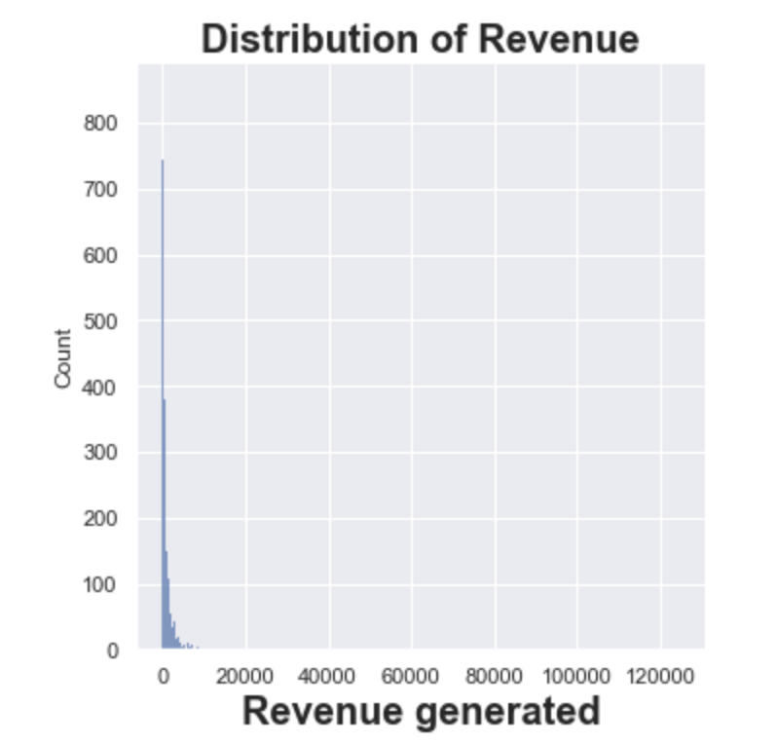
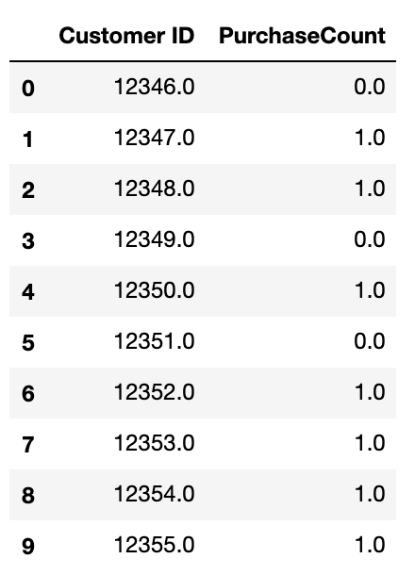
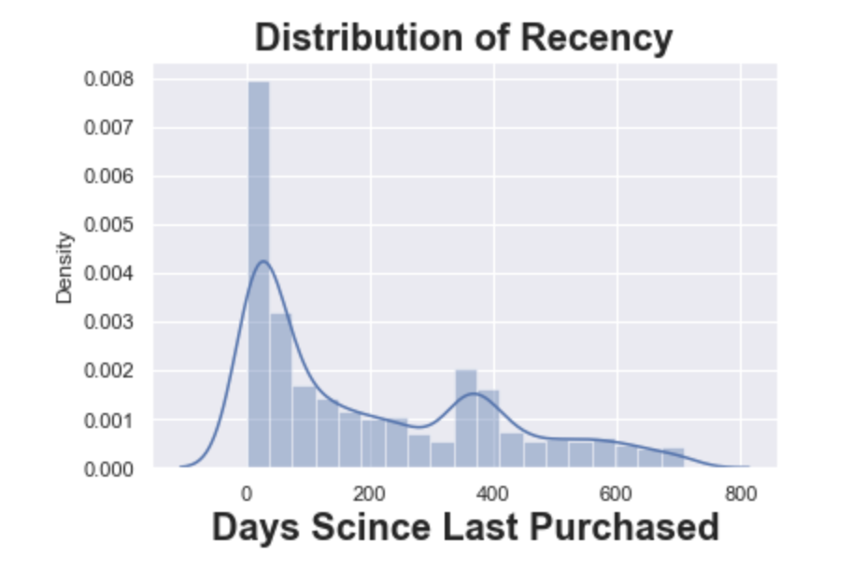
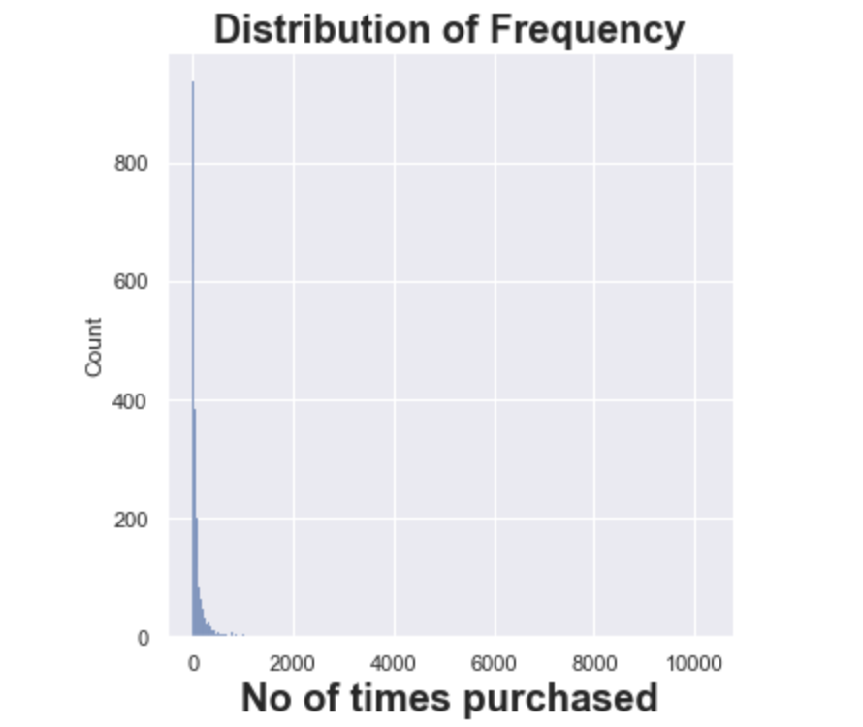
Computing RFM metrics & Output labels
RECENCY
FREQUENCY
MONETARY
OUTPUT LABEL
………….
Train/test split of time-series data
2009-12-01 2010-11-30 2011-05-31
Training features
Training Labels
Testing features
Testing Labels
2010-06-01 2011-05-31 2011-11-09

Slide 4
Modeling & Evaluation
Classification Model
AUC-ROC curve
Confusion Matrix
Logistic Regression
0.77
Class 0 (Precision=0.62, Recall=0.90, f1-score=0.73)
Class 1 (Precision=0.84, Recall=0.49, f1-score=0.62)
Decision Tree
0.60
Class 0 (Precision=0.58, Recall=0.66, f1-score=0.62)
Class 1 (Precision=0.64, Recall=0.55, f1-score=0.59)
Random Forest Classifier
0.76
Class 0 (Precision=0.63, Recall=0.89, f1-score=0.73)
Class 1 (Precision=0.83, Recall=0.51, f1-score=0.63)
kNN
0.71
Class 0 (Precision=0.62, Recall=0.81, f1-score=0.70)
Class 1 (Precision=0.75, Recall=0.53, f1-score=0.62)
Conclusion & Next Steps:
Predict purchase probabilities of each customer utilizing Random Forest Classifier/Logistic regression, and export purchase probabilities
Further try to improve the accuracy of the models by:
using different proportions of train_test_split of time-series data by collecting more data and re-running these scripts
Try to merge the transaction data with Google Analytics data to combine bounce rates, etc
Explore layering some 3P attributes (age, gender, demographic, ethnicity, behavioral category/affinities, etc) to further refine cluster groups

